Slide 1

IOT home application using GSM-based Cellular
Group Members:
Gaurav Sharma(Leader): 9819288665
Alen M Johnson: 9810427495
Koushik KT: 9025097926
Nikhil Kumar: 9939016488
Tharun KC: 8940556749

Slide 2
Abstact
This research work investigates the potential of ‘Full Home Control’, which is the aim of the Home Automation Systems in near future. The analysis and implementation of the home automation technology using Global System for Mobile Communication (GSM) modem to control home appliances such as light, conditional system, and security system via Short Message Service (SMS) text messages is presented in this paper. The proposed research work is focused on functionality of the GSM protocol, which allows the user to control the target system away from residential using the frequency bandwidths. The concept of serial communication and AT-commands has been applied towards development of the smart GSM-based home automation system. Home owners will be able to receive feedback status of any home appliances under control whether switched on or off remotely from their mobile phones. PIC16F887 microcontroller with the integration of GSM provides the smart automated house system with the desired baud rate of 9600 bps. The proposed prototype of GSM based home automation system was implemented and tested with maximum of four loads and shows the accuracy of ≥98%.

Slide 3
Technology
Smart homes contain multiple, connected devices such as home entertainment consoles, security systems, lighting, access control systems and surveillance. Intelligent home automation system is incorporated into smart homes to provide comfort, convenience, and security to home owners . Home automation system represents and reports the status of the connected devices in an intuitive, user-friendly interface allowing the user to interact and control various devices with the touch of a few buttons. Some of the major communication technologies used by today’s home automation system include Bluetooth, WiMAX and Wireless LAN (Wi-Fi), Zigbee, and Global System for Mobile Communication (GSM). All GSM is one of the most widely used cellular technologies in the world . With the increase in the number of GSM subscribers, research and development is heavily supported in further investigating the GSM implementation. The microcontroller acts as the bridge between the GSM network and sensors of the home automation system. Further researches have been conducted to analyze the performance of other home automation control system . Internet and wireless communications have also been utilized in parallel with GSM for home automations . Among the cellular technologies, GSM network is preferred for the communication between the home appliances and the user due to its wide spread coverage which makes the whole system online for almost all the time. Another advantage of using the GSM network in home automation is its high security infrastructure, which provides maximum reliability whereby other people cannot monitor the information sent or received. Hence, this research work implements SMS based control for home appliances using the GSM architecture without accessing the local network.

Slide 4
Novelty
We are making this project by using a GSM module and an Arduino.
GSM module is used in many communication devices which are based on GSM (Global System for Mobile Communications) technology. It is used to interact with GSM network using a computer. GSM module only understands AT commands, and can respond accordingly. The most basic command is “AT”, if GSM respond OK then it is working good otherwise it respond with “ERROR”. There are various AT commands like ATA for answer a call, ATD to dial a call, AT+CMGR to read the message, AT+CMGS to send the sms etc. AT commands should be followed by Carriage return i.e. \r (0D in hex), like “AT+CMGS\r”. We can use GSM module using these commands:

Slide 5
ATE0 - For echo off
AT+CNMI=2,2,0,0,0 <ENTER> - Auto opened message Receiving. (No need to open message)
ATD<Mobile Number>; <ENTER> - making a call (ATD+919610126059;\r\n)
AT+CMGF=1 <ENTER> - Selecting Text mode
AT+CMGS=”Mobile Number” <ENTER> - Assigning recipient’s mobile number
>>Now we can write our message
>>After writing message
Ctrl+Z send message command (26 in decimal).
ENTER=0x0d in HEX

Slide 6
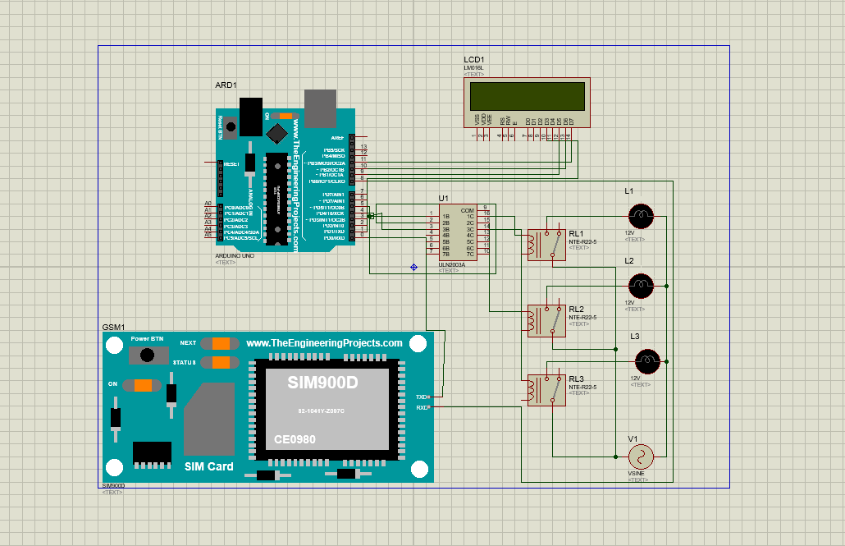
Hardware Simulation

Slide 7
Business scope
The intention of our project “IOT home application using GSM-based Cellular” is to automate the certain functions of home appliances.Smart home technologies have been introduced 30 years ago,mostly relying on some proprietary technologies and applications.As the communication networks has expanded recently,smart home applications can be further enhanced with new capabilities that were not available before.In particular wireless technologies will soon enable exotic and economically feasible applications.The device is much helpful in controlling home.It reduces the wastage of valuable time and our daily life becomes easier and flexible. The proposed system is user friendly, low cost and easy to understand. The range of GSM is global so the user can use the system from any corner of the world. It will automate the home appliances

